Slide 1

Internet of Things Project using Python (CSE 4110) Mid-Term Project Presentation on Raspberry Pi Pico W Remote Controlled Car
Supervisor
Prof. Dr. Subhendu Sarangi
Presented by
Mr. Sayon Mitra
Mr. Sidhartha Raj
Department of Computer Science and Engineering
Institute of Technical Education & Research (FET)
Siksha ‘O’ Anusandhan Deemed to be University, Bhubaneswar
January, 2023

Slide 2
Contents
Introduction
Literature Survey
Project components
Design scheme
Testing
Socio-economic Issues Associated With The Project
Socio-economic Solutions
Conclusion
Acknowledgement
References

Slide 3
INTRODUCTION
INTRODUCTION
The "Raspberry Pi Pico W Remote Controlled Car Robot Web Server" project employs the Raspberry Pi Pico W microcontroller to create a versatile and accessible robotic system. By integrating web server capabilities, users can remotely control the robot using a web interface, eliminating the need for an ultrasonic sensor. The project leverages the Pico W's wireless connectivity to enhance maneuverability and responsiveness. This innovative design offers a cost-effective and efficient solution for enthusiasts seeking a customizable, web-controlled car robot, showcasing the flexibility and power of the Raspberry Pi Pico W in robotics applications.

Slide 4
Project Components:
Project Components
Raspberry Pi Pico W - The Raspberry Pi Pico W is a small, low-cost Microcontroller board based on the RP2040 chip and Wi-Fi and Bluetooth connectivity. Pico W is based on the Raspberry Pi Foundation’s RP2040 chip, which features a dual-core Arm Cortex-M0+ processor running at 133MHz, 264KB of RAM, and a wide range of peripherals including ADCs, and digital interfaces like I2C, SPI, and UART.
Motor Driver (L298N) - The L298N is a popular integrated circuit (IC) motor driver and can control two DC motors or a bipolar stepper motor.
60 RPM Single shaft Motor
Iron chassis
9V Battery
Jumper Wires

Slide 5
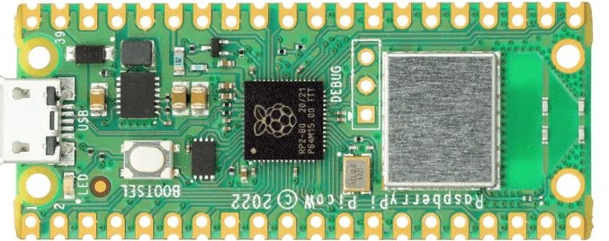
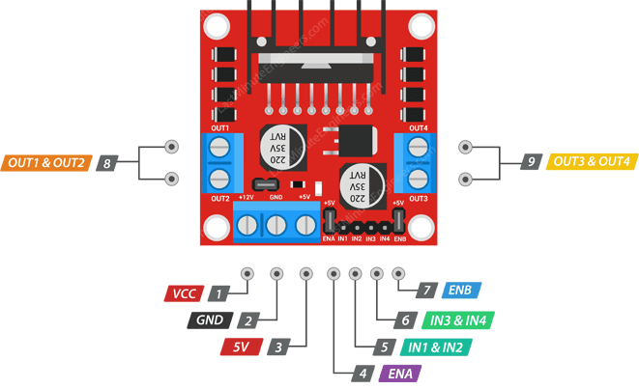
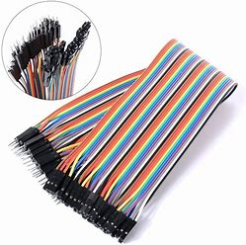
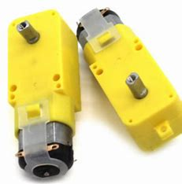
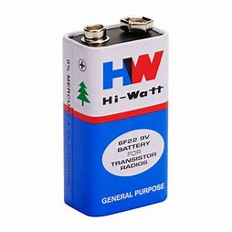
Project Components:
Project Components
Raspberry Pi Pico W
L298N Motor Driver
Jumper Wires
Single Shaft DC Motor
9V Battery

Slide 6
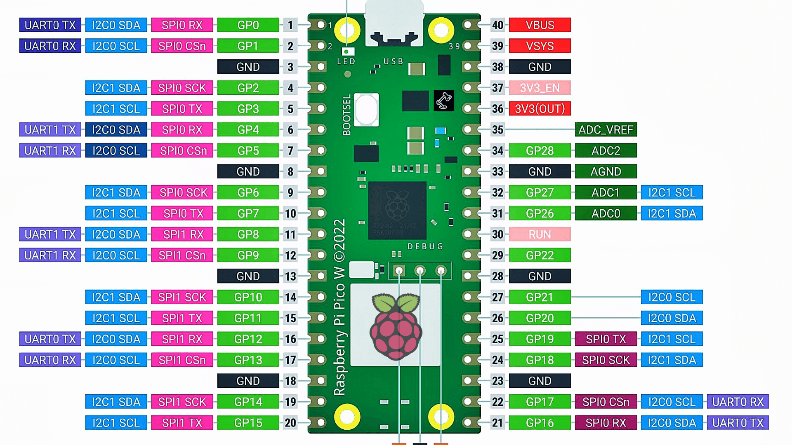
Raspberry Pi Pico W Pinout
Raspberry Pi Pico W Pinout

Slide 7
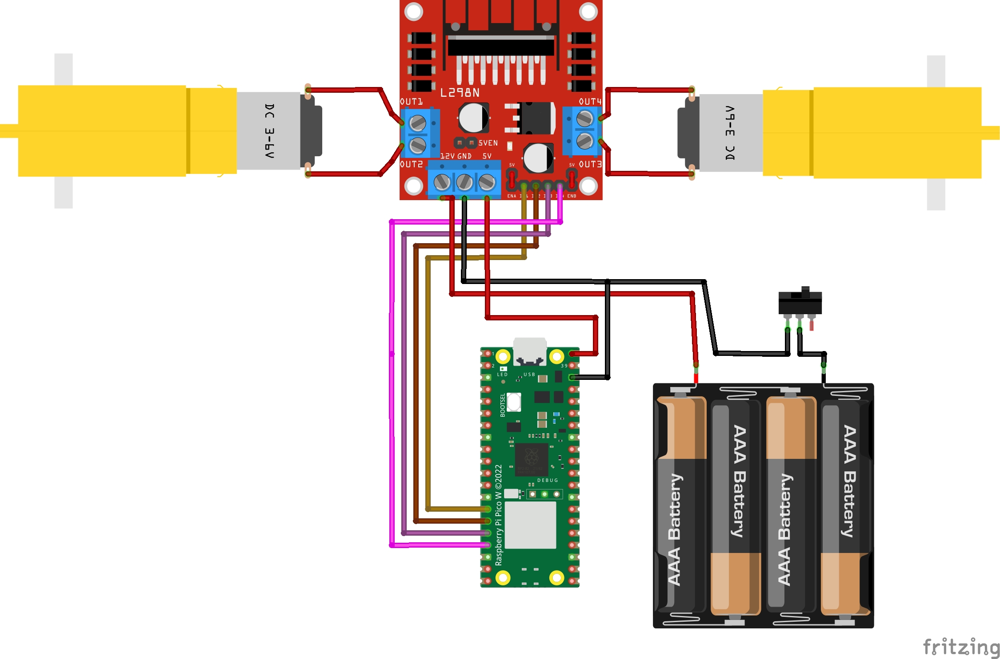
Circuit Diagram
Circuit Diagram

Slide 8
Web Interface
Testing
Key Testing Criteria :-
The SSID & Password in both the Python code and the web interface should
match for Robot to work efficiently.
Revolutionary Approach :-
We can access the unmanned Robot from any remote location wirelessly to
perform different type of task.

Slide 9
Web Interface
Web Interface
We have created web interface for remotely access the Robotic car. In which we had added HTML code to make our Web Interface. Users interact with the robot remotely through a web interface hosted on a server. The interface presents directional buttons such as forward, backward, left, right, and stop. When a user clicks a button, corresponding HTTP requests are sent to the Raspberry Pi Pico on the robot via the server. The Pico W, equipped with motors and GPIO pins, interprets these commands and adjusts the robot's movements accordingly. This enables seamless remote control over the robot's actions. The simplicity of the web interface ensures accessibility from various devices, allowing users to navigate and control the robot intuitively over the internet, providing a user-friendly and efficient means of remote interaction.

Slide 10
Web Interface (Cont.)
Web Interface (Cont.)
Wireless control offers significant advantages in the remote operation of robots. Firstly, it provides unparalleled flexibility, allowing users to control the robot from a distance without physical constraints. This is especially beneficial for applications in hazardous environments, exploration, or surveillance where direct human presence is impractical or unsafe. Wireless control enhances convenience, eliminating the need for cumbersome wired connections, and enables users to navigate the robot freely. Additionally, wireless communication facilitates real-time interactions, enabling swift responsiveness to changing conditions. The ease of implementation and accessibility of wireless technology further contribute to its advantages, making it a versatile and scalable solution for a wide range of robotic applications. Overall, wireless control not only enhances operational efficiency but also opens doors to innovative and dynamic uses of robotic systems in various fields.

Slide 11
Socio-economic Issues Associated With The Project
Socio-economic Issues Associated With The Project
1. Hardware Integration: Integrating the Raspberry Pi Pico with motors, motor drivers, and ensuring proper wiring presented challenges. Ensuring compatibility and proper functioning of all components required meticulous attention to detail.
2. Limited Resources on Raspberry Pi Pico: The limited resources, including memory and processing power, on the Raspberry Pi Pico posed challenges. Optimizing the code and efficiently managing resources became crucial for smooth operation.
3. Wireless Connectivity Stability: Ensuring stable and reliable wireless connectivity was a challenge. Network disruptions or interference could impact the robot's responsiveness, requiring strategies to handle potential connection issues.
4. Security Considerations: Implementing a secure web server and ensuring the safety of data transmitted over the network presented challenges. Addressing potential vulnerabilities and incorporating authentication measures were essential for a robust and secure remote control system.

Slide 12
Solutions
1. Hardware Integration: Thorough documentation and reference to datasheets were used to ensure correct pin connections. Rigorous testing and troubleshooting were conducted to identify and rectify any hardware integration issues. Prototyping and breadboarding were employed to validate the circuit before finalizing the connections.
2. Limited Resources on Raspberry Pi Pico: Code optimization techniques, such as minimizing unnecessary loops and variables, were implemented to reduce resource usage. Additionally, efficient algorithms and data structures were chosen to make optimal use of the available resources on the Raspberry Pi Pico.
3. Wireless Connectivity Stability: Error-handling mechanisms were introduced to detect and recover from network disruptions. The code was designed to handle connection losses gracefully, attempting reconnection and providing feedback to users. Quality of Service (QoS) considerations and the use of reliable communication protocols contributed to enhanced stability.
4. Security Considerations: Secure coding practices were employed to prevent common vulnerabilities. Password protection and encryption were implemented for sensitive data transmitted over the network. Regular updates and monitoring for security patches were part of the maintenance plan. User authentication mechanisms were integrated to ensure that only authorized individuals could control the robot, enhancing overall system security.
Solutions

Slide 13
Conclusion
Conclusion
In conclusion, the development and application of a remotely controlled robot offer a myriad of possibilities across various industries. Overcoming challenges in hardware integration, resource limitations, connectivity stability, and security considerations has led to a versatile and efficient system. The ability to explore hazardous environments, assist in search and rescue missions, provide remote medical services, and contribute to education and research showcases the broad impact of this technology. Additionally, applications in industrial automation, agriculture, entertainment, and security highlight the adaptability and relevance of remotely controlled robots in addressing diverse needs. As technology continues to advance, the role of these robots is likely to expand, opening new avenues for innovation and contributing to the enhancement of efficiency, safety, and accessibility in a multitude of fields. The project serves as a testament to the transformative power of robotics in addressing complex challenges and improving various aspects of our lives.

Slide 14
Acknowledgement
Acknowledgement
I would like to express gratitude to the Raspberry Pi Foundation for providing comprehensive documentation on the Raspberry Pi Pico, facilitating the understanding of hardware integration. Acknowledgment is extended to the MicroPython community for valuable insights into coding practices. Additionally, appreciation goes to web development resources that contributed to the implementation of a remote control interface. This project draws upon the collective knowledge of the open-source and robotics communities, emphasizing the collaborative nature of technological advancements. Special thanks to all contributors whose shared expertise has been instrumental in the successful execution of this remotely controlled robot project.

Slide 15
References
References
DIY Project Lab
ChatGPT
YouTube
Google

Slide 16
THANK YOU

